Slide 1
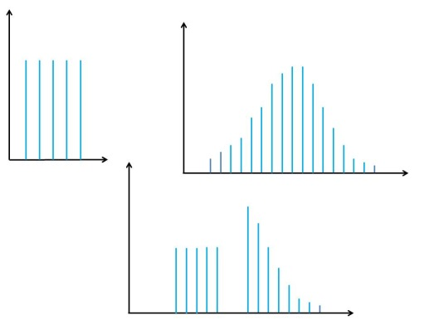

MODELS
EXPERIMENTS
DATA
. . . 1 1 1 1 0 0 1 1 0 0 1 1 1 1 0 1 . . .
f(x)=P(X=x)
P is prob.

